Slide 1


Test Levels and Test Types
Basic Phases and Generic Types of Testing
Software Quality Assurance
Telerik Software Academy
http://academy.telerik.com

Slide 2


The Lectors
Snejina Lazarova
Project Manager
BI & Reporting Team
Dimo Mitev
QA Architect
Backend Services Team

Slide 3

Table of Contents
Test Levels
Component Testing
Integration Testing
System Testing
Acceptance Testing

Slide 4

Table of Contents (2)
Test Types
Risk-Based Testing
Functional Testing
Non-functional Testing
Structural Testing
Testing Related to Changes: Re-testing and Regression Testing
Maintenance Testing

Slide 5
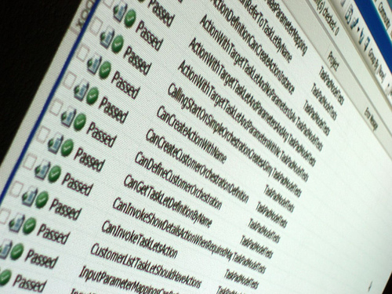
Component Testing
Short Review

Slide 6

Main Terms
Component testing
Testing separate components of the software
Software units (components)
Modules, units, programs, functions
Classes – in Object Oriented Programming
Respective tests are called:
Module, unit, program or class tests

Slide 7

Units vs. Components
Unit
The smallest compilable component
Component
A unit is a component
The integration of one or more components is a component
“One” stands for components that call themselves recursively

Slide 8
Test Objects
Individual testing
Components are tested individually
Isolated from all other software components
Isolation
Prevents external influences on the components
Component test checks aspects internal to the component
Interaction with neighbors is not performed

Slide 9
Component Testing Helpers
Stubs
In Component testing called components are replaced with stubs, simulators, or trusted components
Drivers
Calling components are replaced with drivers or trusted super-components

Slide 10

Integration Testing
Testing Components‘ Collaboration

Slide 11

Integration
Composing units to form larger structural units and subsystems
Done by developers, testers, or special integration teams
Supposes that components are already tested individually

Slide 12
Levels of Integration Testing
Component integration testing
Expose defects in the interfaces and interaction between integrated components
Also called
“Integration test in the small”
System integration testing
Testing the integration of systems and packages
Testing interfaces to external organizations
Also called
“Integration test in the large”

Slide 13

Off-the-shelf Products
Standard, existing components used with some modification
Usually not subject of component testing
Must be tested for integration

Slide 14

Why Integration Testing?
After assembling the components new fault may occur
Testing must confirm that all components collaborate correctly
The main goal - exposing faults
In the interfaces
In the interaction between integrated components

Slide 15

Some Typical Problems
Wrong interface formats
Incompatible interface formats
Wrong files format
Typical faults in data exchange
Syntactically wrong or no data
Different interpretation of received data
Timing problems

Slide 16
Integration Approaches
There are different approaches for integration testing
The Big Bang approach
all components or systems are integrated simultaneously
The main disadvantage: difficult to trace the cause of failures
The incremental approach
The main disadvantage: time-consuming

Slide 17
Incremental Approaches
The Top-Down approach
The high level logic and flow are tested first - the low level components are tested later
The Bottom-Up approach
Opposite to the Top-Down approach
The main disadvantage - the high level or the most complex functionalities are tested late

Slide 18

System Testing
Comparing The System With Requirements

Slide 19
Why System Testing
Previous tests were done against technical specifications
The system test
Looks at the system from another perspective
Of the customer
Of the future user
Many functions and system characteristics result from the interaction of all system components

Slide 20
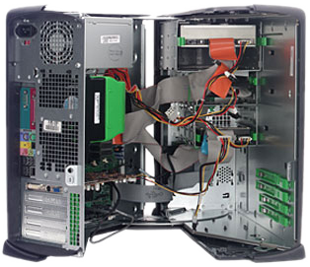
Test Environment
System testing requires specific test environment
Hardware
System software
Device driver software
Networks
External systems
Etc.

Slide 21

Test Environment (2)
A common mistake is testing in the customer’s operational environment
Failures may cause damage to the system
No control on the environment
Parallel processes may influence
The test can hardly be reproduced

Slide 22
Common Problems
Unclear or missing system requirements
Missing specification of the system's correct behavior
Missed decisions
Not reviewed and not approved requirements
Project failure possible
Realization might turn to be in the wrong direction

Slide 23

Acceptance Testing
Involving the Customer Himself

Slide 24
The Main Idea
The focus is on the customer's perspective and judgment
Especially for customer specific software
The customer is actually involved
The only test he can understand
Might have the main responsibility
Performed in a customer’s like environment
As similar as possible to the target environment
New issues may occur

Slide 25

Forms of Acceptance Testing
Typical aspects of acceptance testing:
Contract fulfillment verification
User acceptance testing
Operational (acceptance) testing
Field test (alpha and beta testing)

Slide 26
Contract Fulfillment Verification
Testing according to the contract
Is the development / service contract accomplished
Is the software free of (major) deficiencies
Acceptance criteria
Determined in the development contract
Any regulations that must be adhered to
Governmental, legal, or safety regulations

Slide 27
User Acceptance Testing
The client might not be the user
Every user group must be involved
Different user groups may have different expectations
Rejection even by a single user group may be problematic

Slide 28

Acceptance In Advance
Acceptance tests can be executed within lower test levels
During integration
E.g. a commercial off-the-shelf software
During component testing
For component’s usability
Before system testing
Using a prototype
For new functionality

Slide 29
Operational (Acceptance) Testing
Acceptance by the system administrators
Testing backup/restore cycles
Disaster recovery
User management
Maintenance tasks
Security vulnerabilities

Slide 30
Field Testing
Software may be run on many environments
All variations cannot be represented in a test
Testing with representative customers
Alpha testing
Carried out at the producer's location
Beta testing
Carried out at the customer's side

Slide 31

Test Types

Slide 32

Risk-Based Testing
Prioritization Of Tests Based On Risk And Cost

Slide 33

Risk
Risk
The possibility of a negative or undesirable outcome or event
Any problem that may occur
Would decrease perceptions of product quality or project success

Slide 34
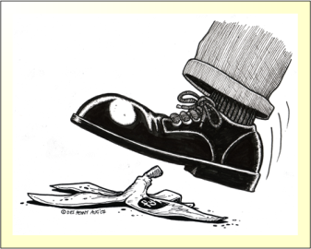
Types of Risk
Two main types of risk are concerned
Product (quality) risks
The primary effect of a potential problem is on the product quality
Project (planning) risks
The primary effect is on the project success

Slide 35
Levels of Risk
Not all risks are equal in importance
Factors for classifying the level of risk:
Likelihood of the problem occurring
Arises from technical considerations
E.g. programming languages used, bandwidth of connections, etc.
Impact of the problem in case it occurs
Arises from business considerations
E.g. financial loss, number of users affected, etc.

Slide 36
Levels of Risk - Chart
RISK
Likelihood
(Probability of failure)
Use frequency
Lack of quality
Impact
(damage)

Slide 37

Prioritization of Effort
Effort is allocated proportionally to the level of risk
The more important risks are tested first

Slide 38

Product Risks: What to Think About
Which functions and attributes are critical (for the success of the product)?
How visible is a problem in a function or attribute?
(For customers, users, people outside)
How often is a function used?
Can we do without?

Slide 39

Functional Testing
Verifying a System's Input-Output Behavior

Slide 40
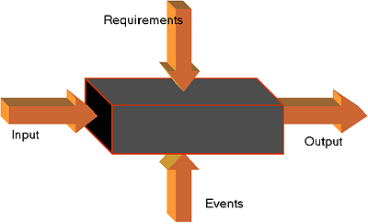
Functional Testing
Functional testing verifies the system's input–output behavior
Black box testing methods are used
The test bases are the functional requirements

Slide 41

Functional Requirements
They specify the behavior of the system
“What" the system must be able to do?
Define constraints on the system

Slide 42
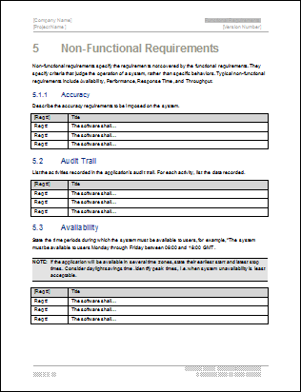
Requirements Specifications
Functional requirements must be documented
Requirements management system
Text based Software Requirements Specification (SRS)

Slide 43

Software Requirements Specifications (SRS)
Live Demo
Notes:
http://www.aspera-3.org/idfs/APAF_SRS_V1.0.pdf

Slide 44

Requirements-based Testing
Requirements are used as the basis for testing
At least one test case for each requirement
Usually more than one is needed
Mainly used in:
System testing
Acceptance testing

Slide 45

Non-functional Testing
Testing Non-functional Software Characteristics

Slide 46

Testing the System Attributes
“How well" or with what quality the system should carry out its function
Attributive characteristics:
Reliability
Usability
Efficiency

Slide 47
Testability of Requirements
Nonfunctional requirements are often not clearly defined
How would you test:
“The system should be easy to operate”
“The system should be fast”
Requirements should be expressed in a testable way
Make sure every requirement is testable
Make it early in the development process

Slide 48
Nonfunctional Tests
Performance test
Processing speed and response time
Load test
Behavior in increasing system loads
Number of simultaneous users
Number of transactions
Stress test
Behavior when overloaded

Slide 49

Nonfunctional Tests (2)
Volume test
Behavior dependent on the amount of data
Testing of security
Against unauthorized access
Service attacks
Stability
Mean time between failures
Failure rate with a given user profile
Etc.

Slide 50
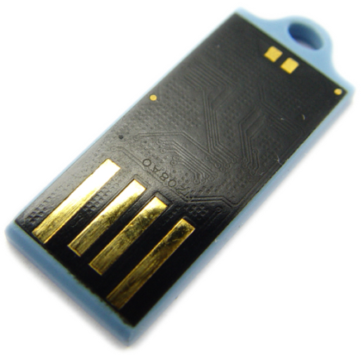
Nonfunctional Tests (3)
Robustness test
Response
Examination of exception handling and recovery to errors
Compatibility and data conversion
Compatibility to given systems
Import/export of data

Slide 51

Nonfunctional Tests (4)
Different configurations of the system
Back-to-back testing
Usability test
Ease of learning the system
Ease and efficiency of operation
Understandability of the system

Slide 52
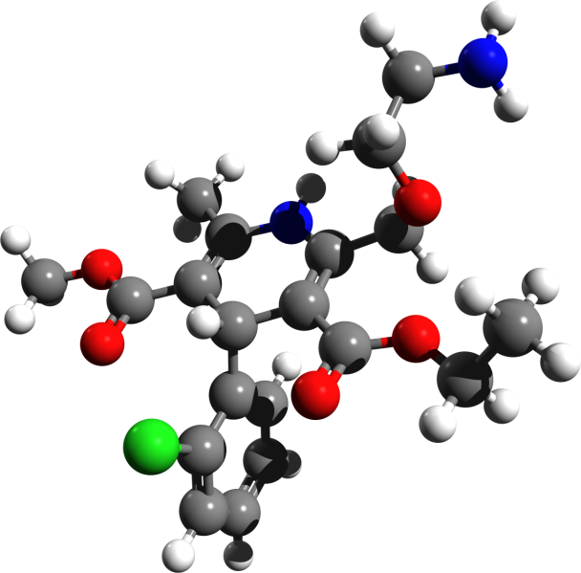
Structural Testing
Testing the Software Structure / Architecture

Slide 53
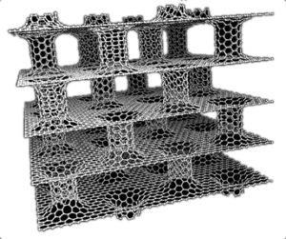
Examining the Structure
Often referred to as ‘white-box’ or ‘glass-box’ testing
Uses information about the internal code structure or architecture
Tools can be used to measure the code coverage of elements, such as statements or decisions

Slide 54

Structure Testing Application
Mostly used for:
Component testing
Integration testing
Can also be applied at:
System integration
Acceptance testing

Slide 55

Testing Related to Changes: Re-testing and Regression Testing
Repeating Tests After Changes Are Made

Slide 56

Re-testing
After a defect is detected and fixed, the software should be re-tested
To confirm that the original defect has been successfully removed
This is called confirmation

Slide 57

What is Regression Testing
Retest of a previously tested program
Needed after modifications of the program
Testing for newly introduced faults
As a result of the changes made to the system
May be performed at all test levels

Slide 58

Tests Reusability
Test cases, used in regression testing, run many times
They have to be well documented and reusable
Strong candidates for test automation

Slide 59
Volume of the Regression Test
How extensive a regression test should be?
There are a few levels of testing extensity:
Defect retest (confirmation testing)
Rerunning tests that have detected faults
Testing altered functionality
Only changed or corrected parts

Slide 60

Volume of the Regression Test (2)
There are a few levels of testing extensity:
Testing new functionality
Testing newly integrated program parts
Complete regression test
Testing the whole system

Slide 61

Unexpected Side Effects
The main trouble of software
The code complexity
Altered or new code parts may affect unchanged code
Testing only code, that is changed, is not enough

Slide 62
Complete Regression Test
The only way to be sure (as possible)
System environment changes
Also require regression testing
Could have effects on every part of the system
Too time consuming and costly
Not achievable in a reasonable cost
Impact analysis of the changes is needed

Slide 63

Maintenance Testing
Testing New Versions of The Software

Slide 64
What Do We Maintain?
Software does not wear out and tear
Some design faults already exist
Bugs are about to be revealed
A software project does not end with the first deployment
Once installed, it will often be used for years or decades
It will be changed, updated, and extended many times

Slide 65

What Do We Maintain? (2)
New versions
Each time a correction is made - a new version of the original product is created
Testing the changes can be difficult
Outdated or missing system specifications

Slide 66

Main Types Of Maintenance
Adaptive maintenance
Product is adapted to new operational conditions
Corrective maintenance
Defects being eliminated

Slide 67
Common Reasons For Maintenance
The system is run under new operating conditions
Not predictable and not planned
The customers express new wishes
Rarely occurring special cases
Not anticipated by design
New methods and classes need to be written
Rarely occurring crashes reported

Slide 68
Testing After Maintenance
Anything new or changed should be tested
Regression testing is required
The rest of the software should be tested for side effects
What if the system is unchanged?
Testing is needed even if only the environment is changed

Slide 69
Test Levels and Test Types
?
?
?
?
?
Questions?
?
?
?
?
?
?

Slide 70
Exercises
Which of the following is a test type?
Component testing
Functional testing
System testing
Acceptance testing

Slide 71
Exercises (2)
Which of these is a functional test?
Measuring response time on an on-line booking system
Checking the effect of high volumes of traffic in a call-center system
Checking the on-line bookings screen information and the database contents against the information on the letter to the customers
Checking how easy the system is to use

Slide 72
Exercises (3)
Which of the following is a true statement regarding the process of fixing emergency changes?
There is no time to test the change before it goes live, so only the best developers should do this work and should not involve testers as they slow down the process
Just run the retest of the defect actually fixed
Always run a full regression test of the whole system in case other parts of the system have been adversely affected
Retest the changed area and then use risk assessment to decide on a reasonable subset of the whole regression test to run in case other parts of the system have been adversely affected

Slide 73
Exercises (4)
Which of the following are characteristics of regression testing ?
Regression testing is run ONLY once
Regression testing is used after fixes have been made
Regression testing is often automated
Regression tests need not to be maintained
Regression testing is not needed when new functionality is added.

Slide 74
Exercises (5)
Non-functional testing includes:
Testing to see where the system does not function correctly
Testing the quality attributes of the system including reliability and usability
Gaining user approval for the system
Testing a system feature using only the software required for that function

Slide 75
Exercises (6)
Where may functional testing be performed?
At system and acceptance testing levels only
At all test levels
At all levels above integration testing
At the acceptance testing level only

Slide 76
Exercises (7)
Which of the following is correct?
Impact analysis assesses the effect on the system of a defect found in regression testing
Impact analysis assesses the effect of a new person joining the regression test team
Impact analysis assesses whether or not a defect found in regression testing has been fixed correctly
Impact analysis assesses the effect of a change to the system to determine how much regression testing to do

Slide 77
Exercises (8)
What is beta testing?
Testing performed by potential customers at the developers location
Testing performed by potential customers at their own locations
Testing performed by product developers at the customer's location
Testing performed by product developers at their own locations

Slide 78
Exercises (9)
Which is the non-functional testing?
Performance testing
Unit testing
Regression testing
Sanity testing

Slide 79
Exercises (10)
What determines the level of risk?
The cost of dealing with an adverse event if it occurs
The probability that an adverse event will occur
The amount of testing planned before release of a system
The likelihood of an adverse event and the impact of the event

Slide 80
Exercises (11)
The difference between re-testing and regression testing is:
Re-testing is running a test again; regression testing looks for unexpected side effects
Re-testing looks for unexpected side effects; regression testing is repeating those tests
Re-testing is done after faults are fixed; regression testing is done earlier
Re-testing uses different environments, regression testing uses the same environment
Re-testing is done by developers, regression testing is done by independent testers

Slide 81
Exercises (12)
Contract and regulation testing is a part of
System testing
Acceptance testing
Integration testing
Smoke testing

Slide 82




Free Trainings @ Telerik Academy
C# Programming @ Telerik Academy
csharpfundamentals.telerik.com
Telerik Software Academy
academy.telerik.com
Telerik Academy @ Facebook
facebook.com/TelerikAcademy
Telerik Software Academy Forums
forums.academy.telerik.com

